Slide 1


Slide 2
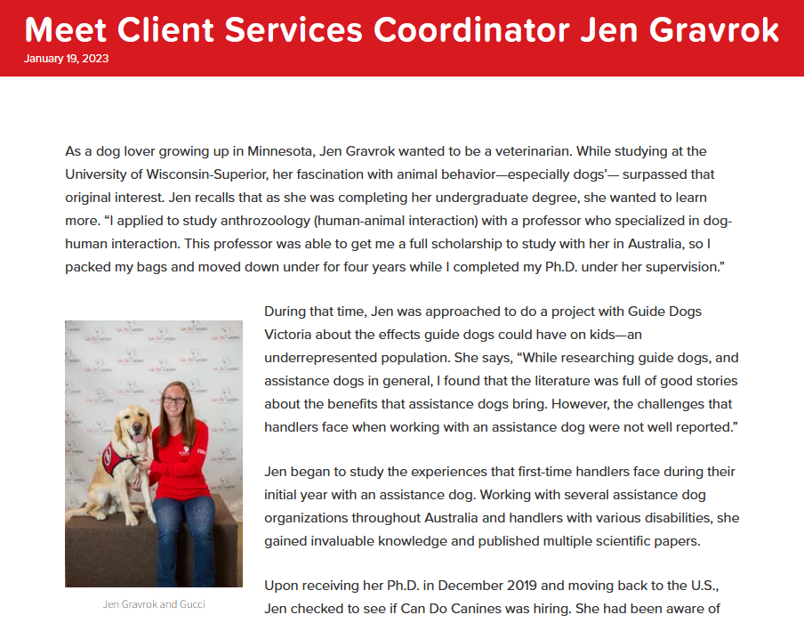
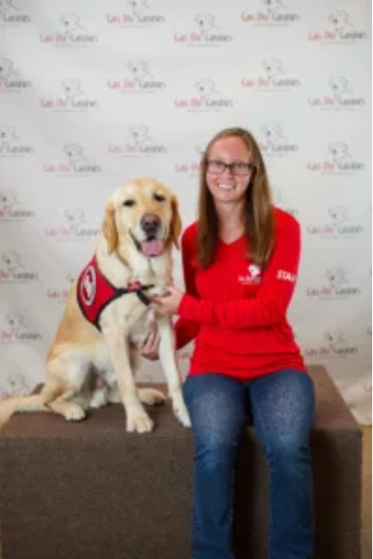

Slide 3
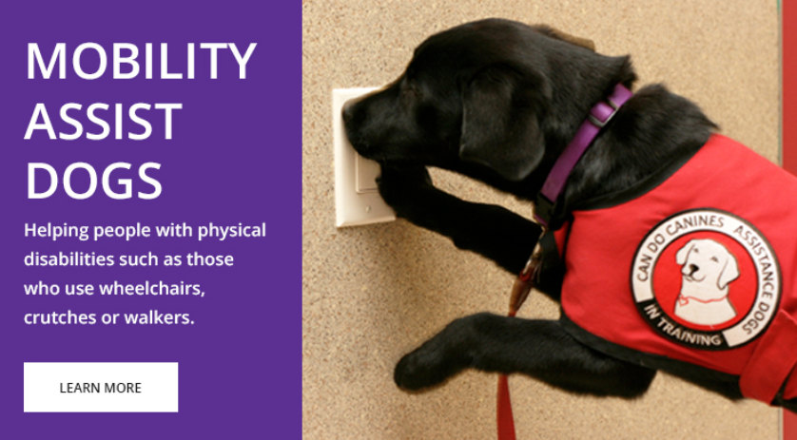

Slide 4
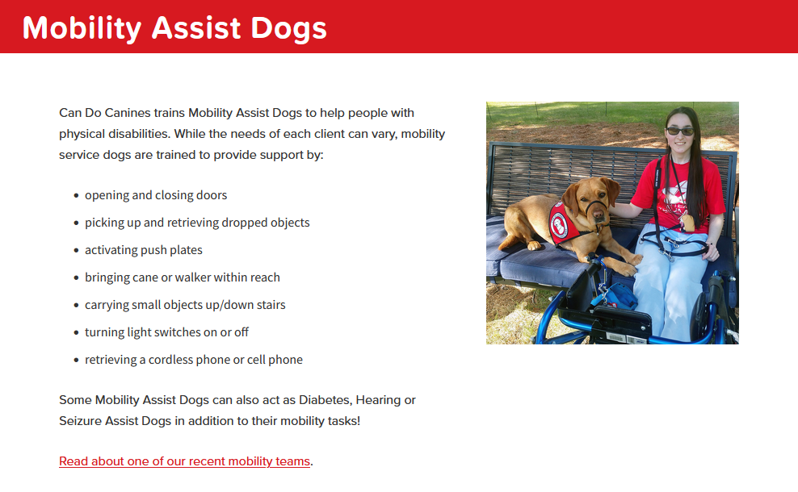

Slide 5
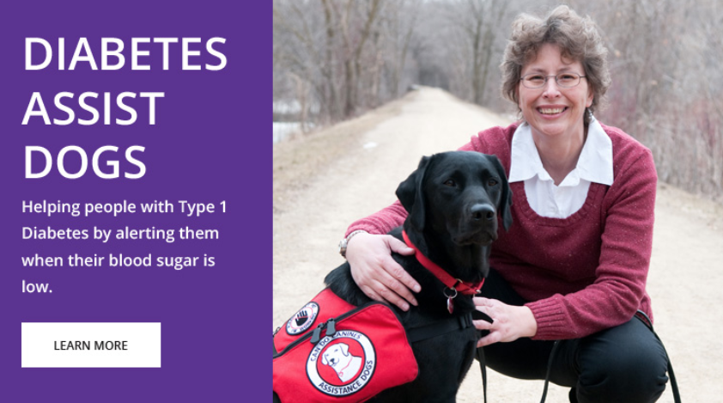

Slide 6
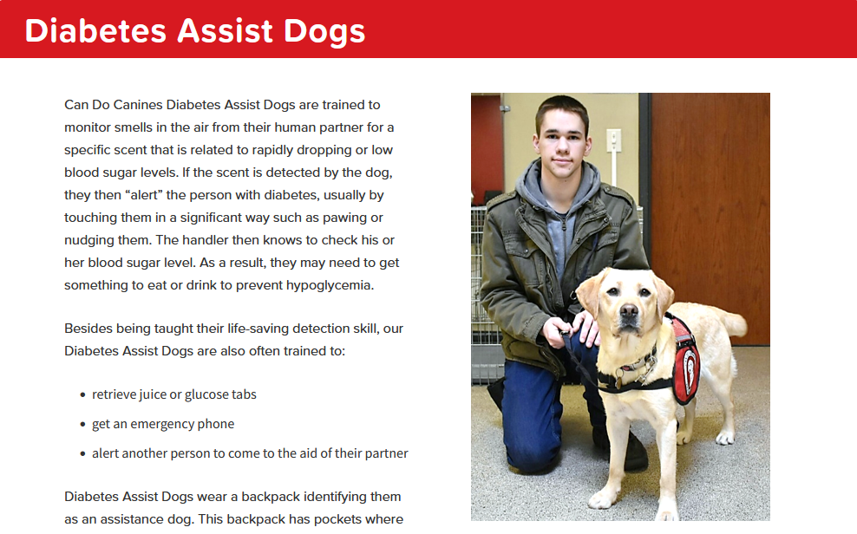

Slide 7
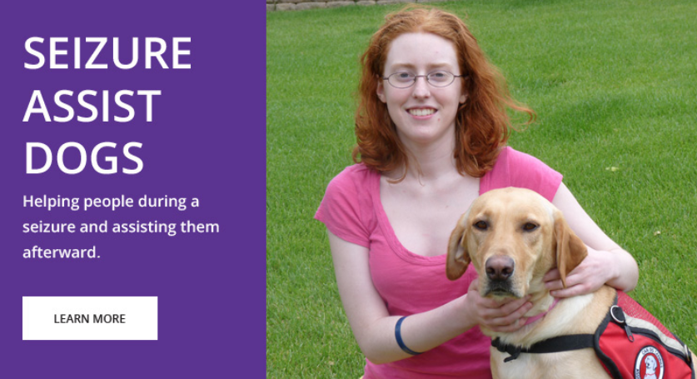

Slide 8
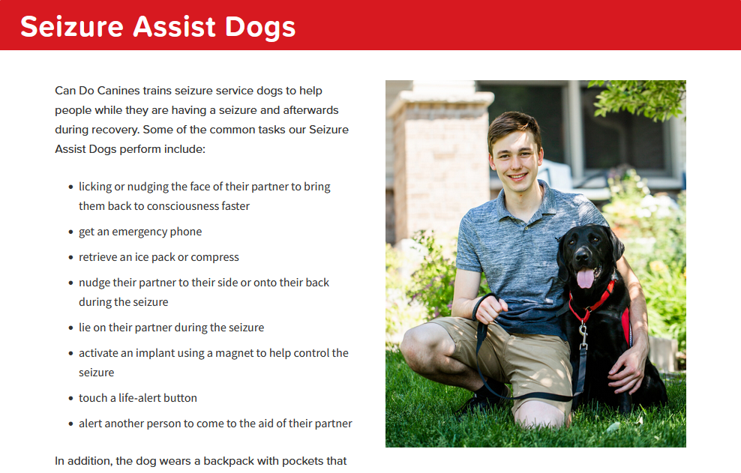

Slide 9
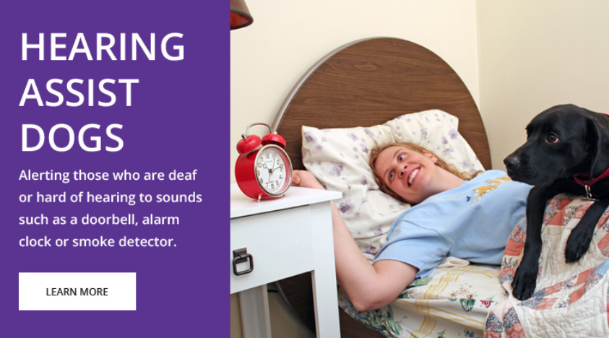

Slide 10
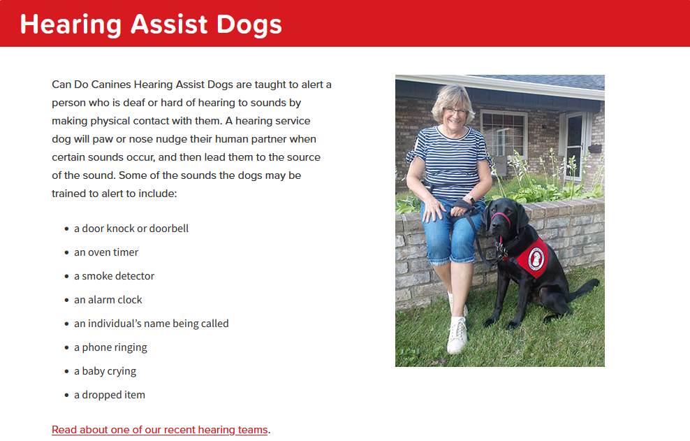

Slide 11
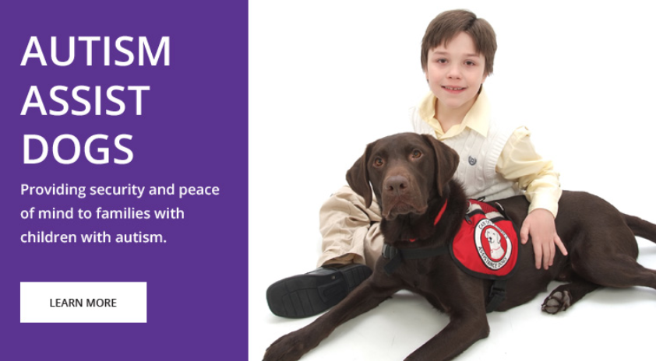

Slide 12
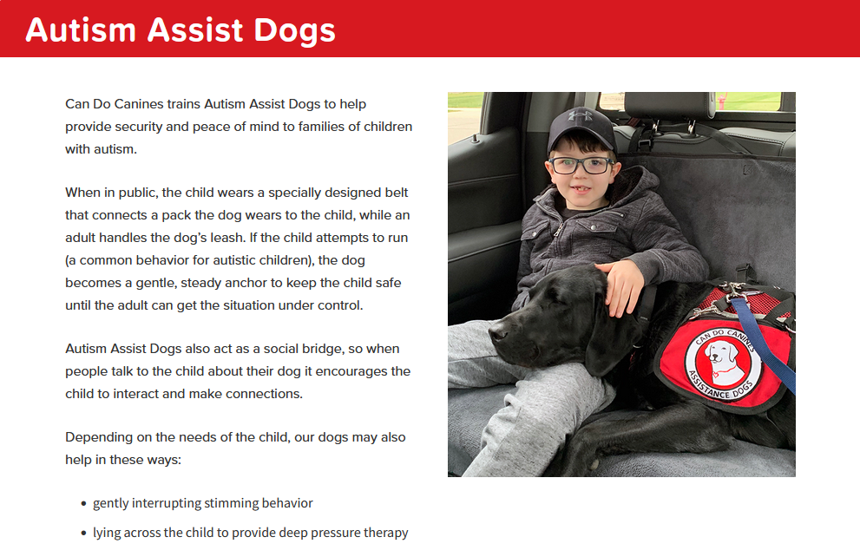

Slide 13
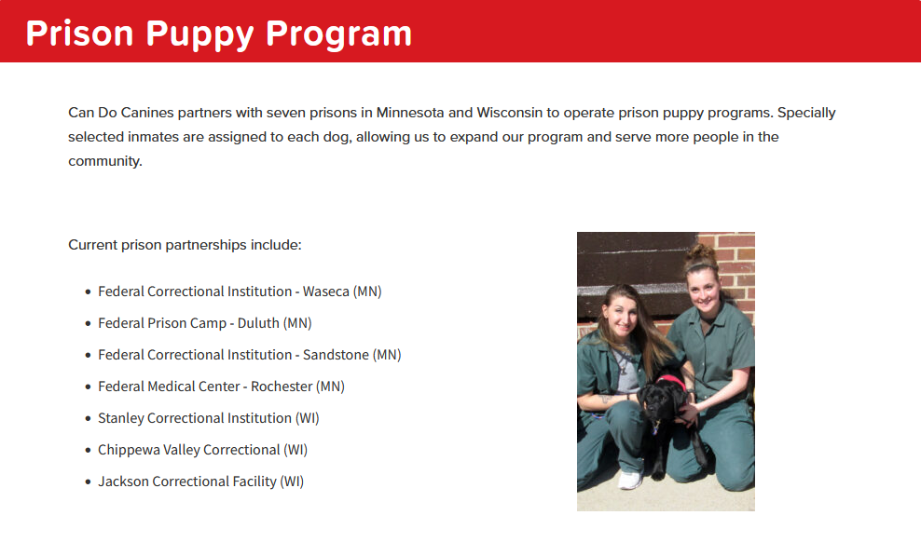

Slide 14
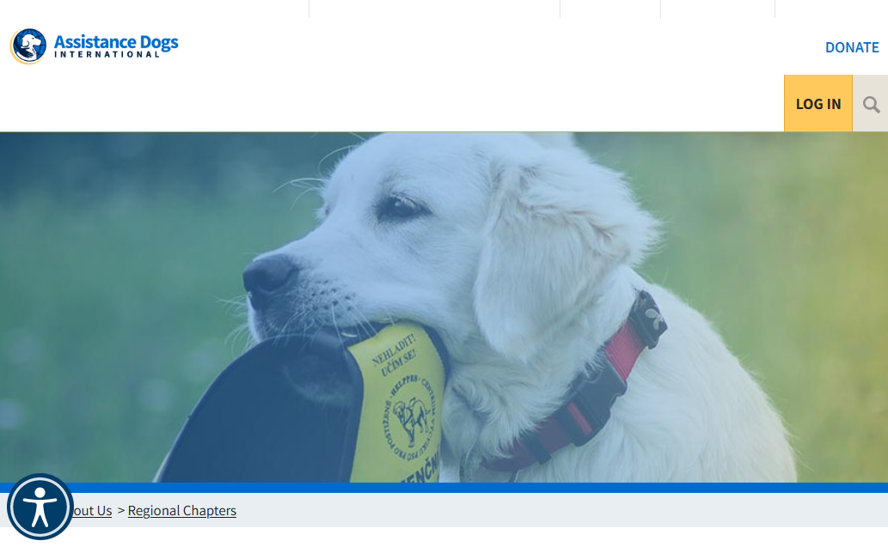
Assistance Dogs International

Slide 15


https://www.youtube.com/watch?v=tvbN6uYeSlc

Slide 17

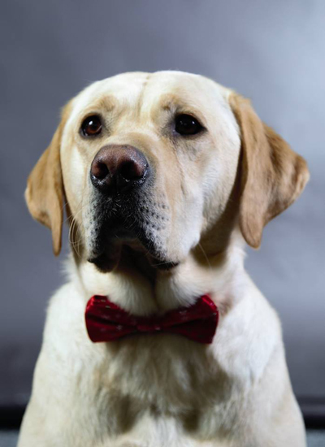
Meet Bentley, the Hearing Assist Service Dog

Slide 18
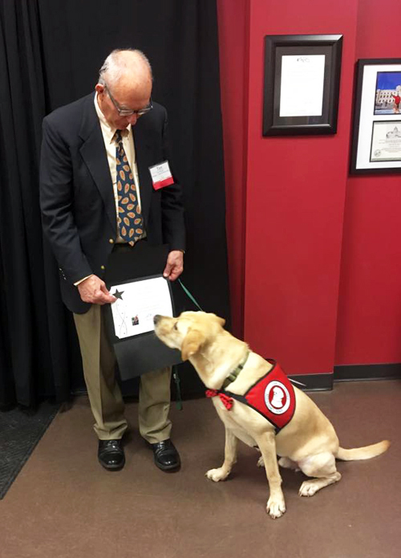
Tim and his Hearing Assistant Partner Bentley are graduates of the Can Do Canines Assistance Dog training program
New Hope, MN

Slide 20
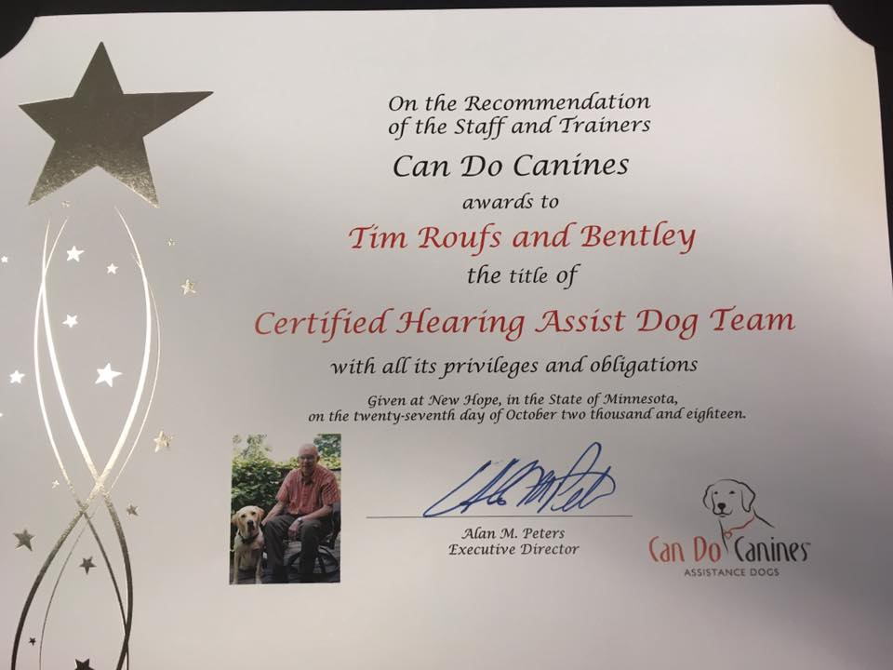

Slide 21
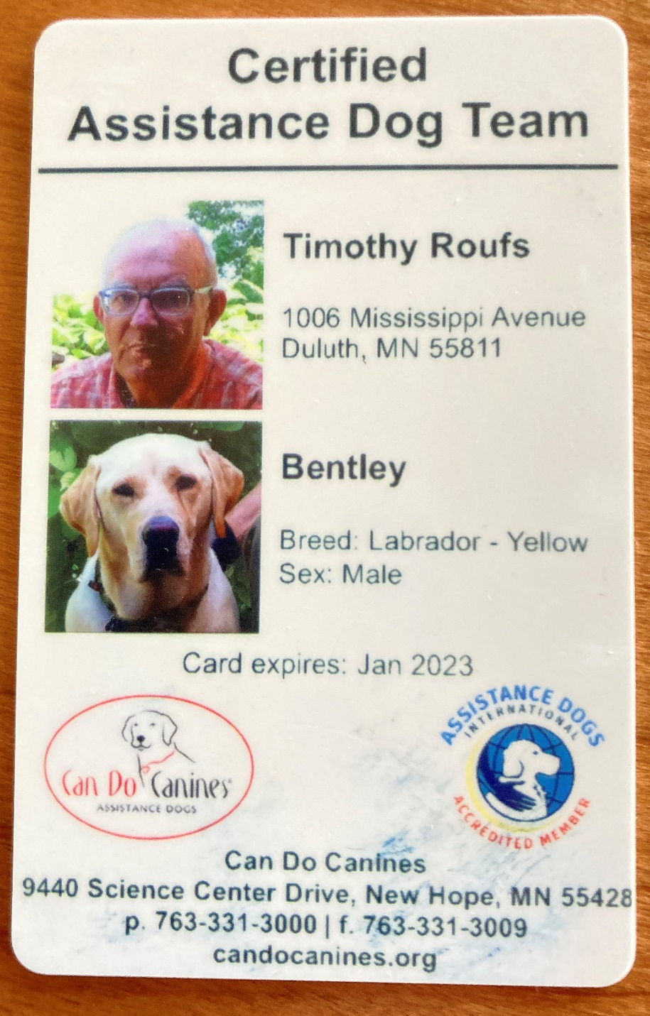

Slide 22
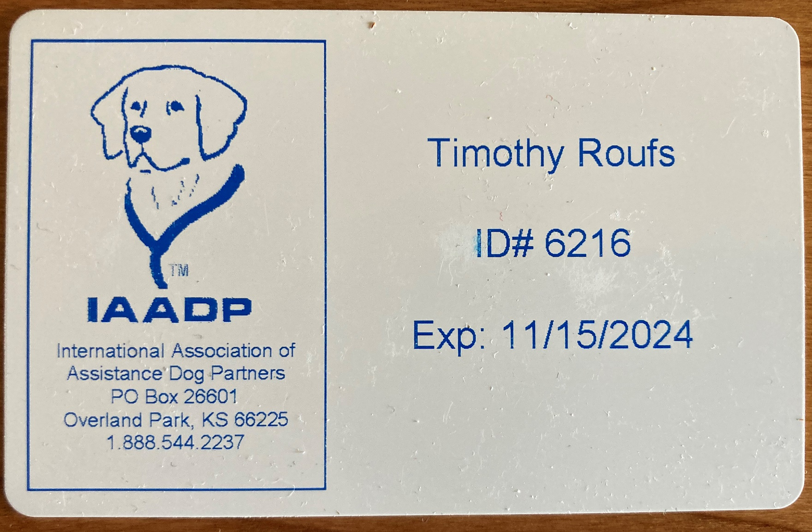

Slide 23
What do
“fake” service dog
cards look like?

Slide 24
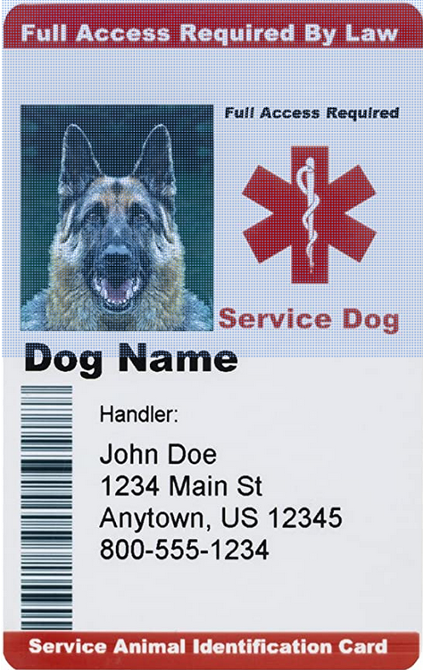
What do
“fake” service dog
cards look like?

Slide 25
"Total Confidence in Bentley"
Can Do Canines Assistant Dog Feature Story
6 February 2019
link

Slide 26
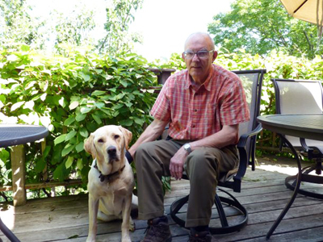
Can Do Canines
is an accredited member of Assistance Dogs International
a nonprofit organization whose purpose is to improve the areas of training, placement and utilization of assistance dogs

Slide 27
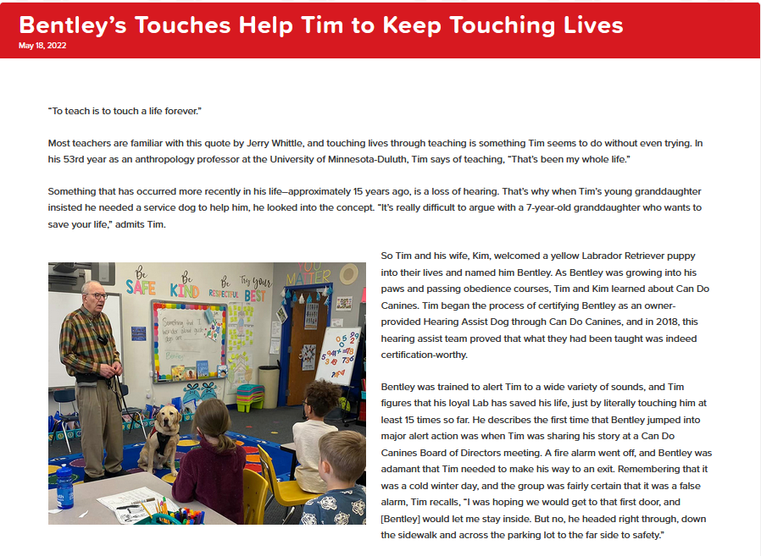

Slide 28
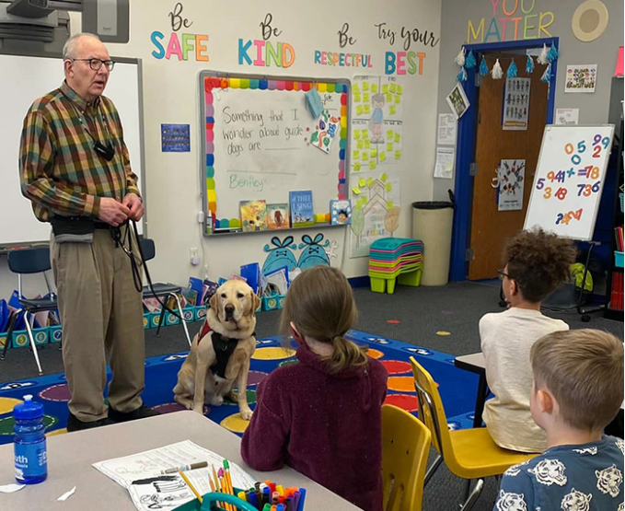

Slide 29
Meet Bentley, the Hearing Assist Service Dog

Slide 30
One of the questions we’re often asked,
about a subject of confusion amongst the general public, is . . .
“What is the difference between a ‘service dog’ and a ‘therapy dog’?”
And we’re also asked what’s the difference between those two and an
“emotional support dog”?
?

Slide 31
One of the questions we’re often asked,
about a subject of confusion amongst the general public, is . . .
“What is the difference between a ‘service dog’ and a ‘therapy dog’?”
And we’re also asked what’s the difference between those two and an
“emotional support dog”?

Slide 32
One of the questions we’re often asked,
about a subject of confusion amongst the general public, is . . .
“What is the difference between a ‘service dog’ and a ‘therapy dog’?”
And we’re also asked what’s the difference between those two and an
“emotional support dog”?

Slide 33
One of the questions we’re often asked,
about a subject of confusion amongst the general public, is . . .
“What is the difference between a ‘service dog’ and a ‘therapy dog’?”
And we’re also asked what’s the difference between those two and an
“emotional support dog”?

Slide 34
trained in specific tasks to assist just one person
Americans with Disabilities Act (ADA) covered:
Rights to bring animals into public establishments
One of the questions we’re often asked,
about a subject of confusion amongst the general public, is . . .
“What is the difference between a ‘service dog’ and a ‘therapy dog’?”
And we’re also asked what’s the difference between those two and an
“emotional support dog”?

Slide 36
trained in specific tasks to assist just one person
Americans with Disabilities Act (ADA) covered:
Rights to bring animals into public establishments
One of the questions we’re often asked,
about a subject of confusion amongst the general public, is . . .
“What is the difference between a ‘service dog’ and a ‘therapy dog’?”
And we’re also asked what’s the difference between those two and an
“emotional support dog”?

Slide 37
One of the questions we’re often asked,
about a subject of confusion amongst the general public, is . . .
“What is the difference between a ‘service dog’ and a ‘therapy dog’?”
And we’re also asked what’s the difference between those two and an
“emotional support dog”?

Slide 38
One of the questions we’re often asked,
about a subject of confusion amongst the general public, is . . .
“What is the difference between a ‘service dog’ and a ‘therapy dog’?”
And we’re also asked what’s the difference between those two and an
“emotional support dog”?
provides emotional
support and comfort
to many people

Slide 39
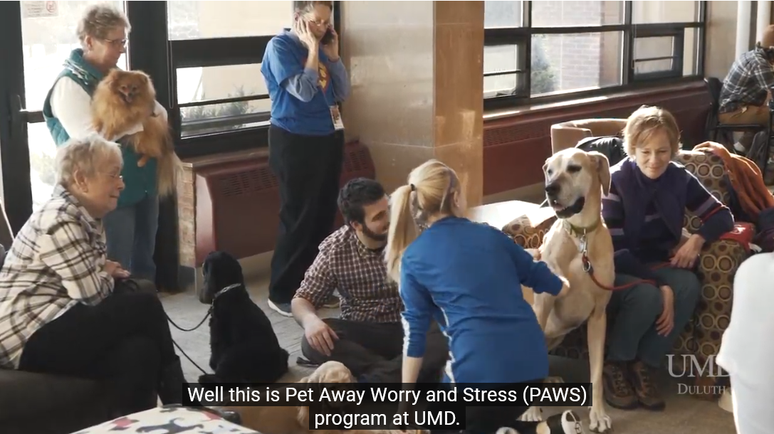
provide emotional
support and comfort
to many people
UMD PAWS Therapy Dogs
helping students with exam anxiety

Slide 40
One of the questions we’re often asked,
about a subject of confusion amongst the general public, is . . .
“What is the difference between a ‘service dog’ and a ‘therapy dog’?”
And we’re also asked what’s the difference between those two and an
“emotional support dog”?

Slide 41
One of the questions we’re often asked,
about a subject of confusion amongst the general public, is . . .
“What is the difference between a ‘service dog’ and a ‘therapy dog’?”
And we’re also asked what’s the difference between those two and an
“emotional support dog”?
primary function is to provide emotional support through companionship to a specific person

Slide 42
may live with their disabled owners, even if “No Pets” policy is in place
One of the questions we’re often asked,
about a subject of confusion amongst the general public, is . . .
“What is the difference between a ‘service dog’ and a ‘therapy dog’?”
And we’re also asked what’s the difference between those two and an
“emotional support dog”?

Slide 43
need to tolerate a wide variety of experiences, environments, and people
One of the questions we’re often asked,
about a subject of confusion amongst the general public, is . . .
“What is the difference between a ‘service dog’ and a ‘therapy dog’?”
And we’re also asked what’s the difference between those two and an
“emotional support dog”?

Slide 44
need to tolerate a wide variety of experiences, environments, and people
One of the questions we’re often asked,
about a subject of confusion amongst the general public, is . . .
“What is the difference between a ‘service dog’ and a ‘therapy dog’?”
And we’re also asked what’s the difference between those two and an
“emotional support dog”?
that is, they must behave at all times in public

Slide 45
trained in specific tasks to assist just one person
ADA covered (Americans with Disabilities Act):
Rights to bring animals into public establishments
REM:
One of the questions we’re often asked,
about a subject of confusion amongst the general public, is . . .
“What is the difference between a ‘service dog’ and a ‘therapy dog’?”
And we’re also asked what’s the difference between those two and an “emotional support dog”?

Slide 46
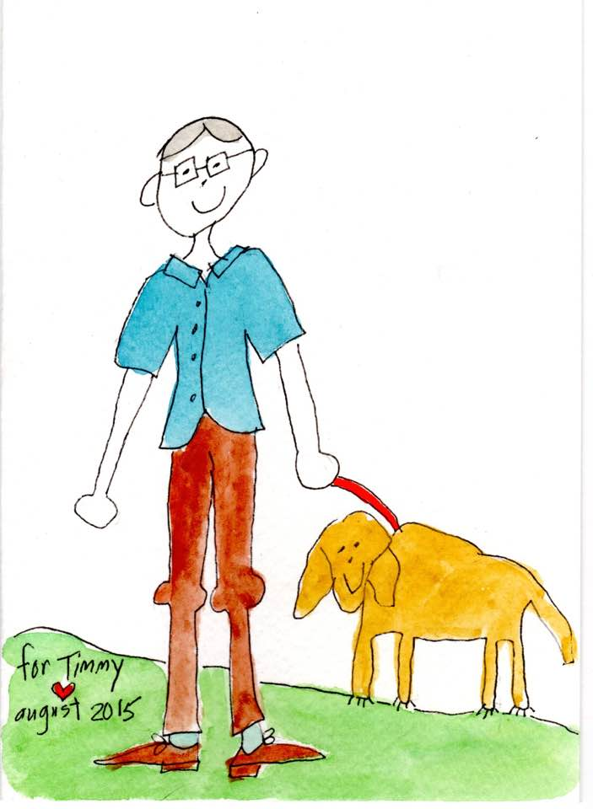
Timmy and Bentley
Gretchen Roufs, 2015

Slide 47
Bentley alerts for the alarm . . . But has no “snooze button”

Slide 48
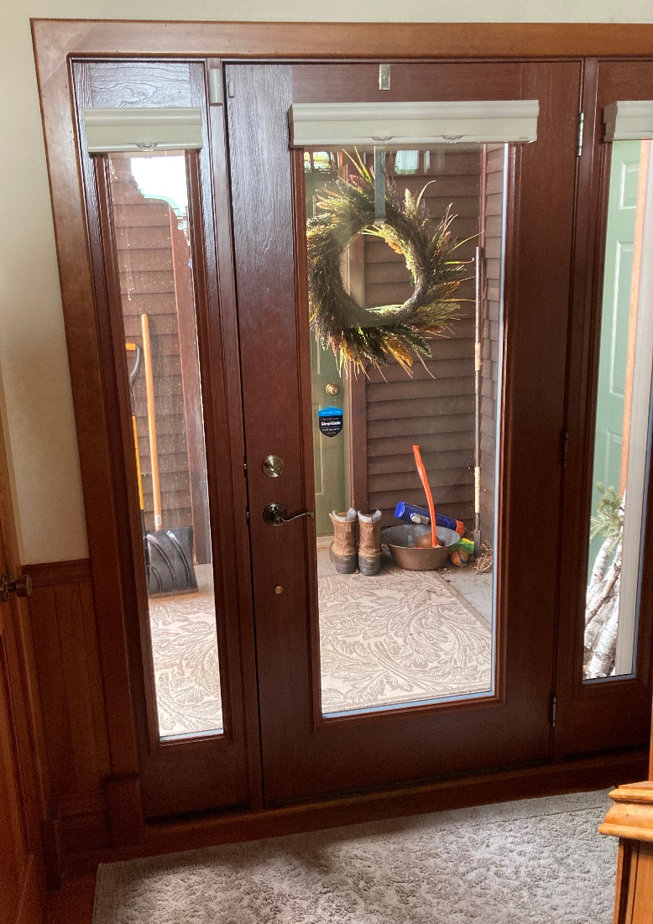
Bentley alerts for the doorbell

Slide 49
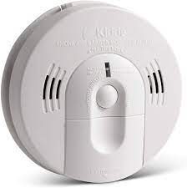
Bentley alerts for the smoke/fire/
CO₂ alarm

Slide 50
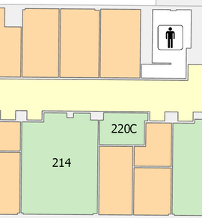
Bentley alerts for someone at my office door

Slide 51
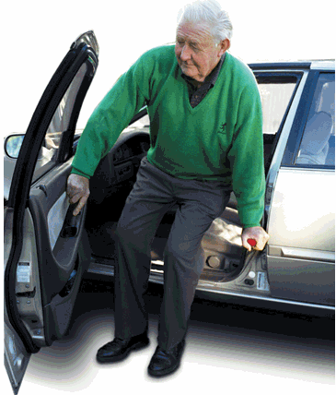
Bentley alerts to people getting out of a car in the driveway

Slide 52
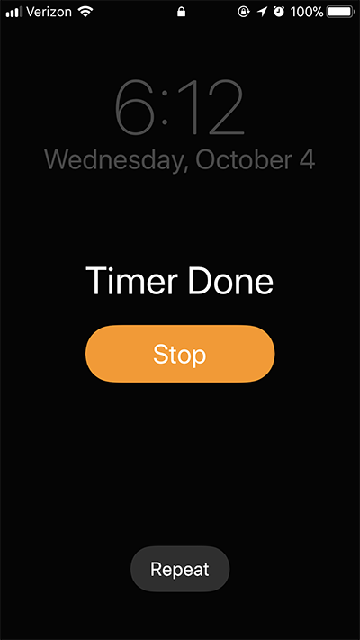
Bentley alerts for the timer on the phone

Slide 53

Bentley is trained to ignore the microwave timer
Bentley is trained to ignore the dishwasher timer
Bentley alerts for the oven timer

Slide 54
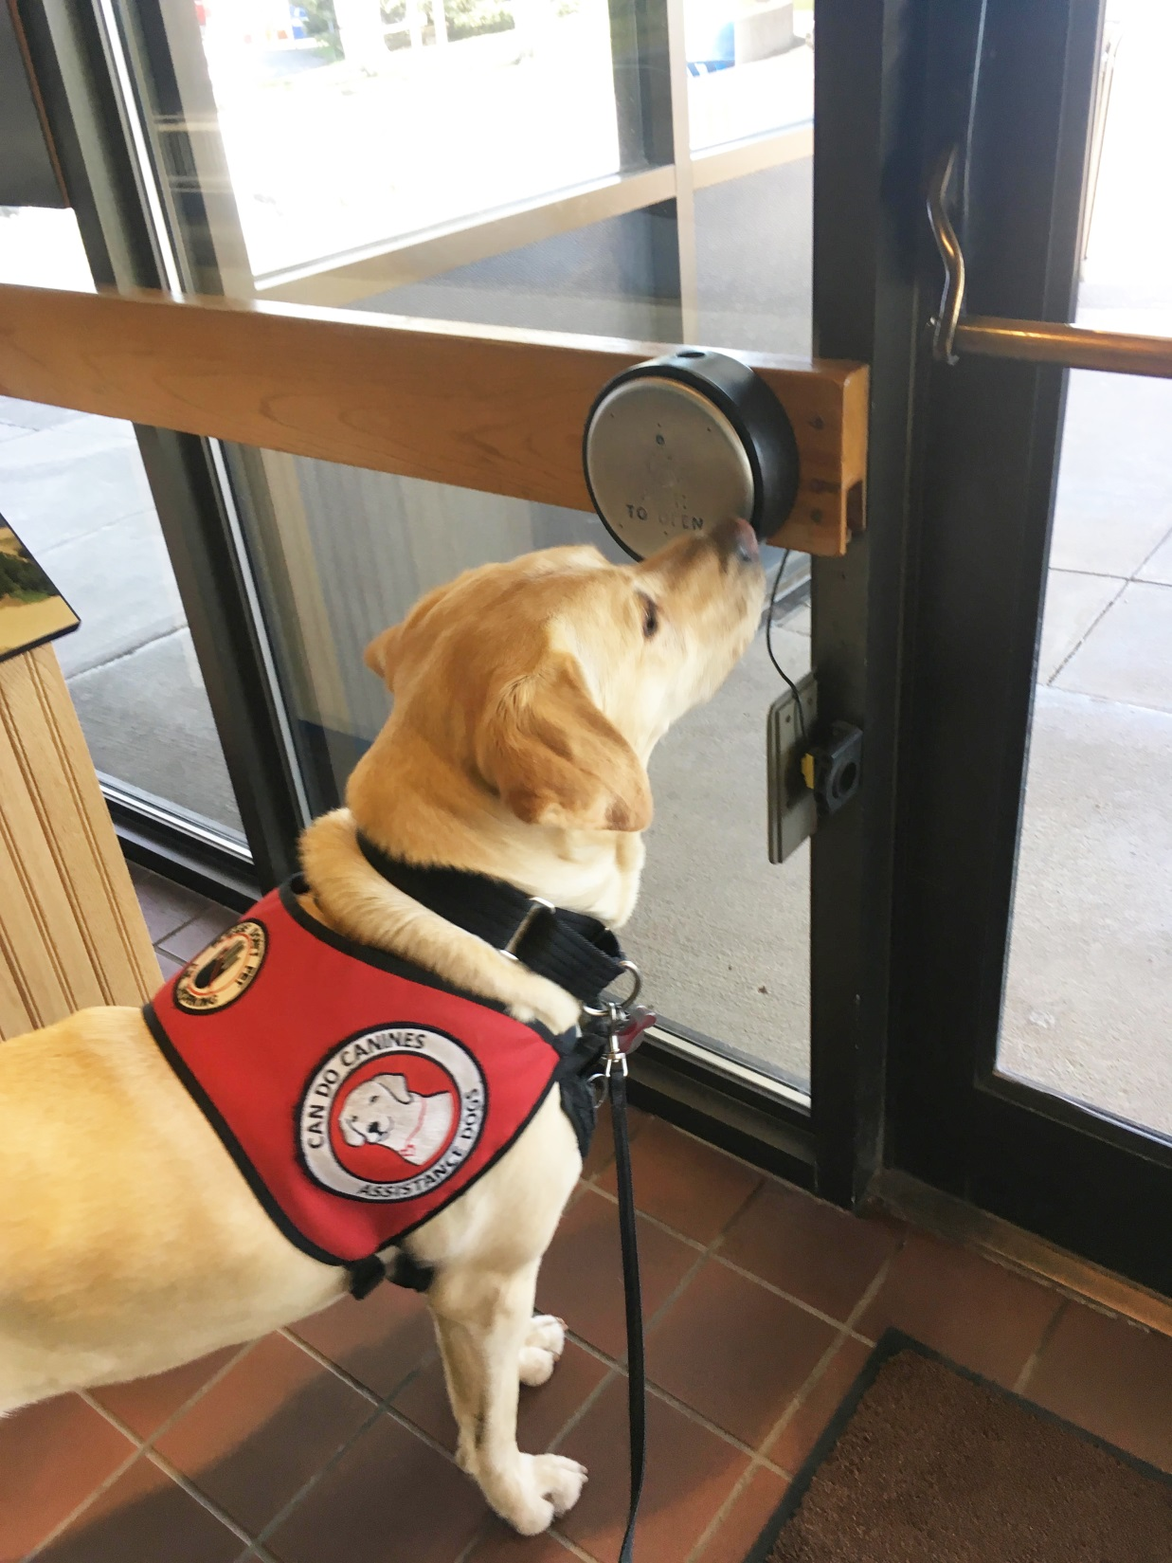
While Bentley is certified as a hearing assist dog
he loves doing other things that his certified mobility assist friends do . . .
Door opener

Slide 55
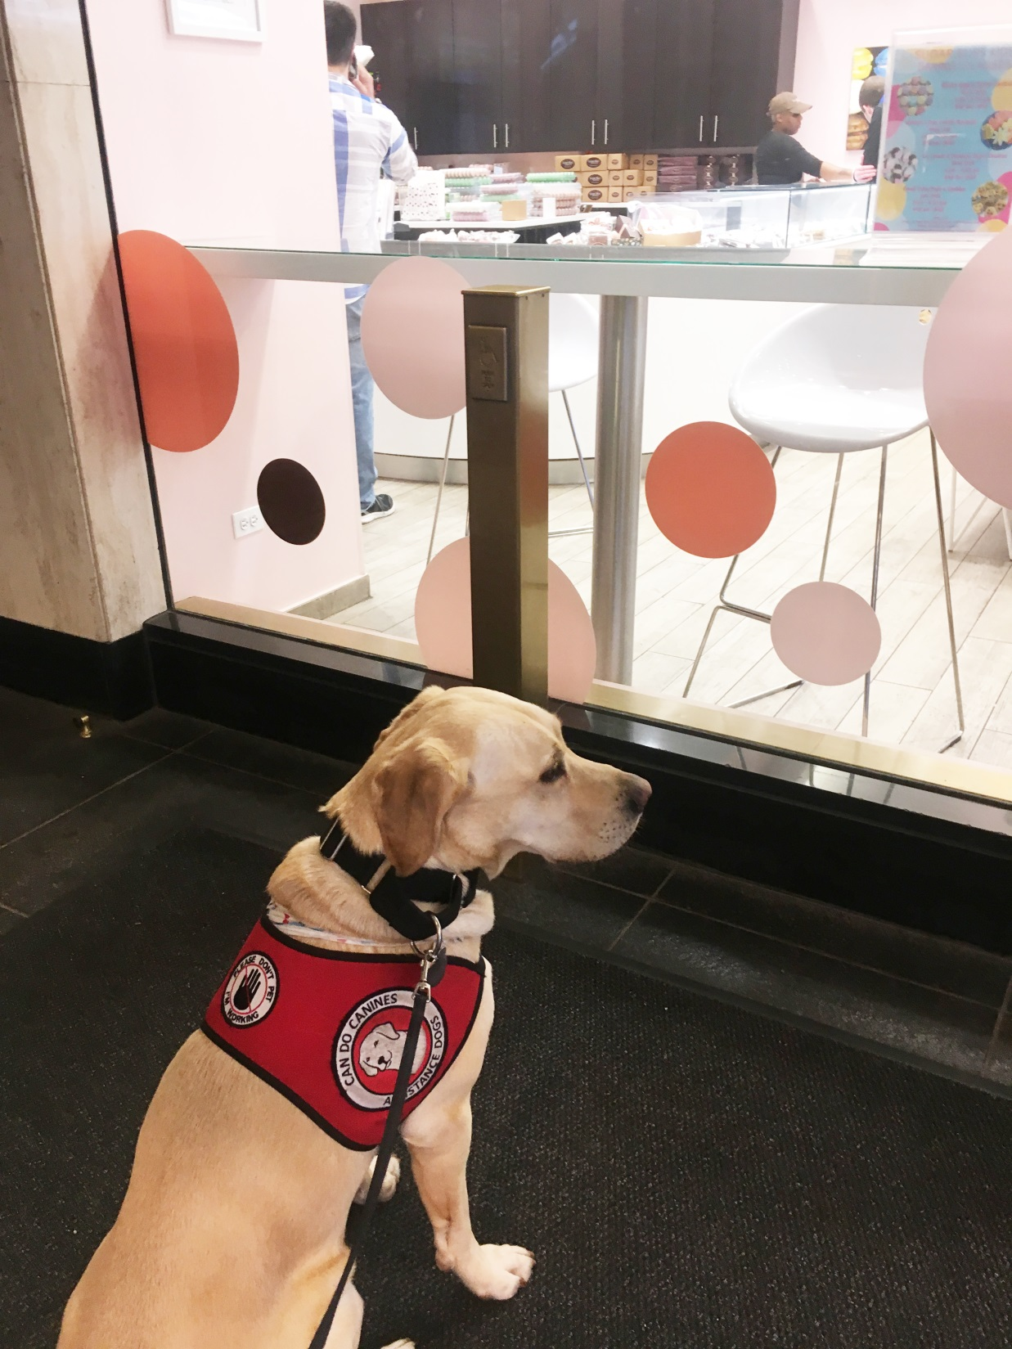
And Bentley is a genius natural problem solver . . .
The door opening button at the Palmer House in Chicago is right above his head . . .
Door opener

Slide 56
And Bentley is a genius natural problem solver . . .
Bentley has never seen a rectangular door-opening button like this before
. . .
Door opener
What the heck is this?

Slide 57
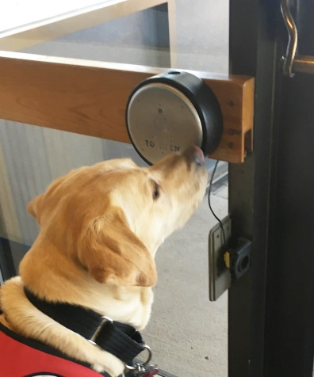
Door opener
Bentley’s unprompted first choice to open the door was . . .
the circle decal on the window
. . .

Slide 58
Door opener
Bentley’s unprompted first choice to open the door was . . .
the circle decals on the window
. . .

Slide 59
And Bentley on his own, after trying the two opener-size decals on the window, opened the door . . .
Door opener

Slide 60
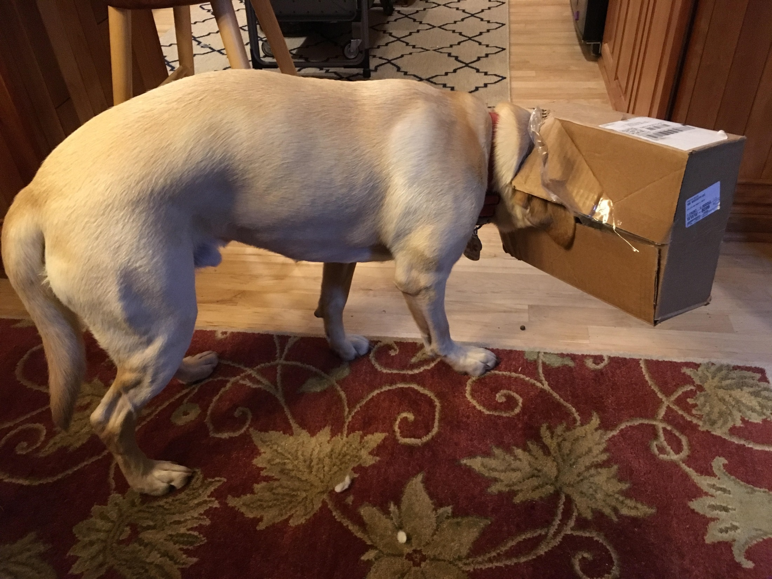
Off duty Bentley is also a great help with opening packages
(also not in his job description)

Slide 61
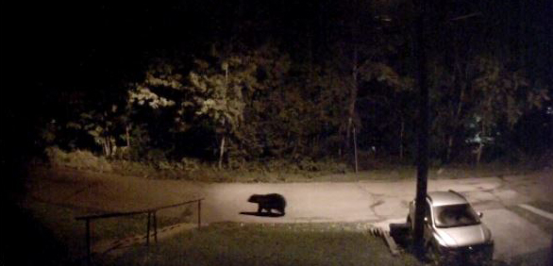
Bentley protects us from the neighbors
(also not in his job description)

Slide 62
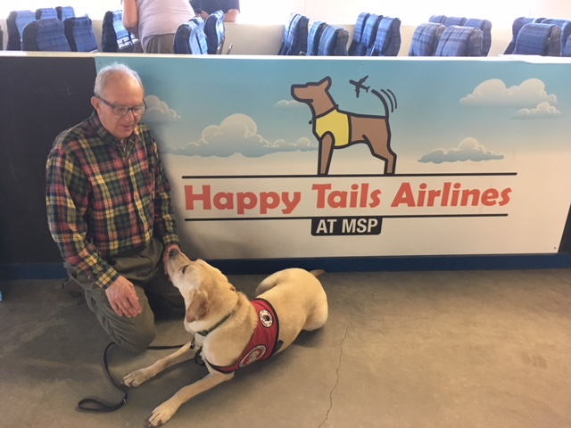
Bentley loves to travel
(he has his official “wings” but hasn’t actually flown yet)

Slide 63
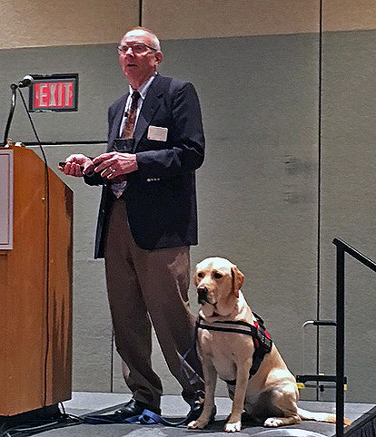
Bentley loves to listen to stories about Can Do dogs
Tim Roufs and Bentley Fox Roufs
Allen D. Leman Swine Conference
CEFANS
College to career Seminar for High School Students

Slide 64
You CAN HELP

Slide 65
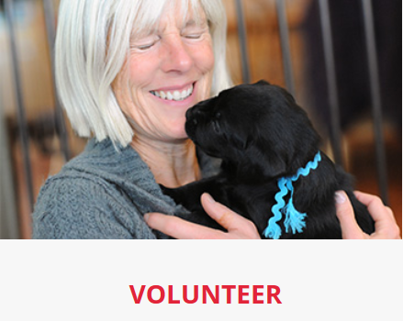

Slide 66
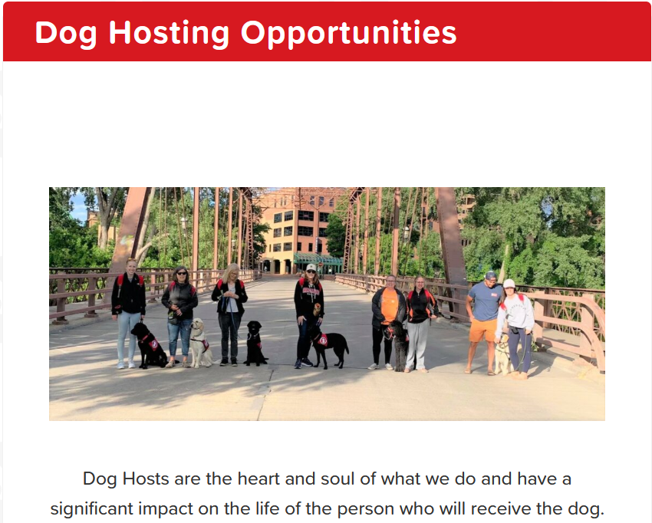

Slide 67
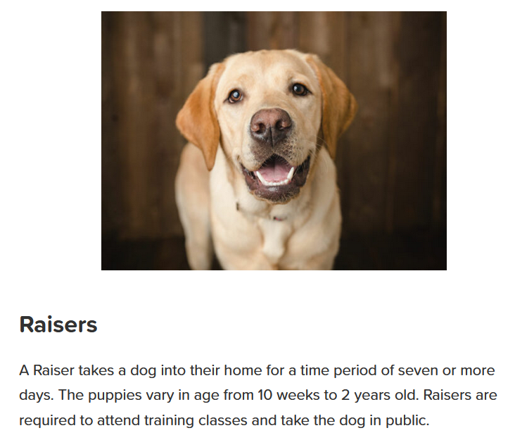

Slide 68
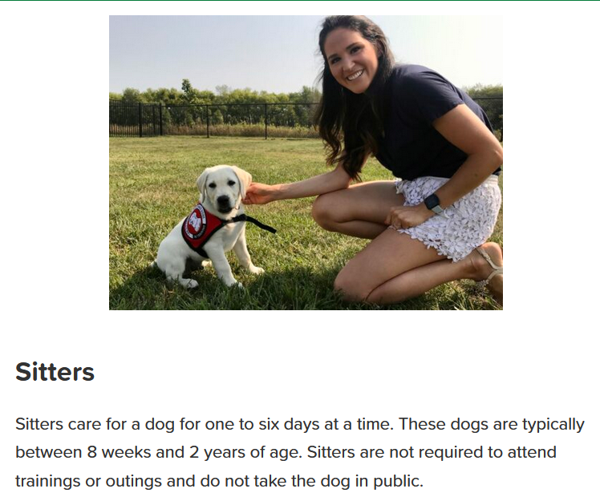

Slide 69
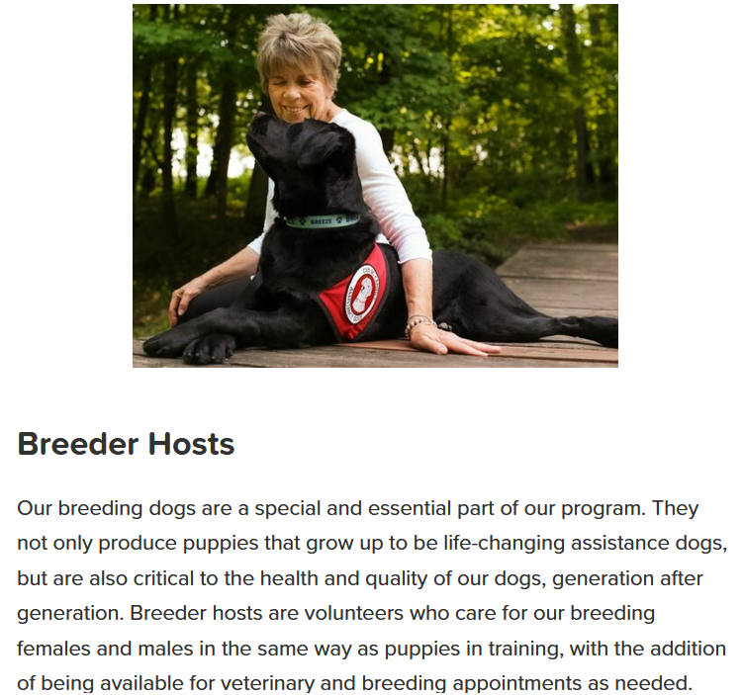

Slide 70
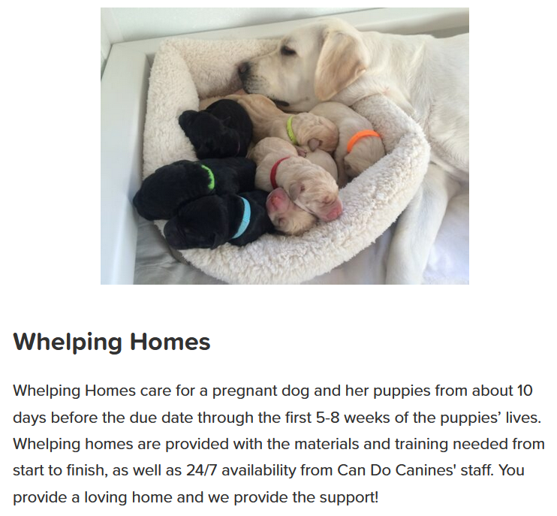

Slide 71
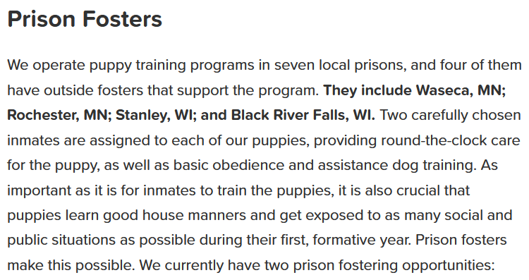
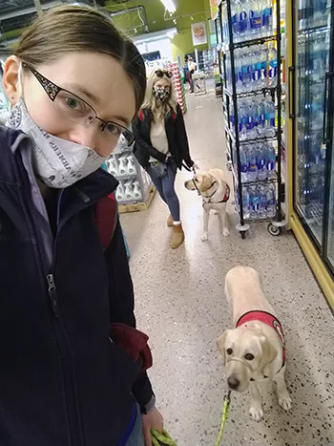

Slide 72


Slide 73
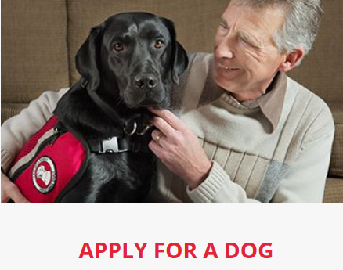

Slide 74
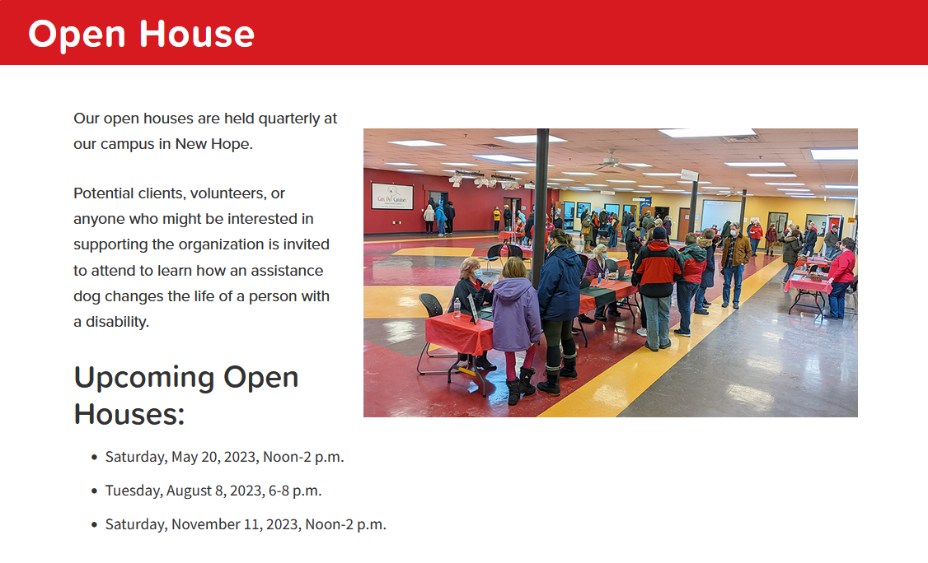

Slide 75
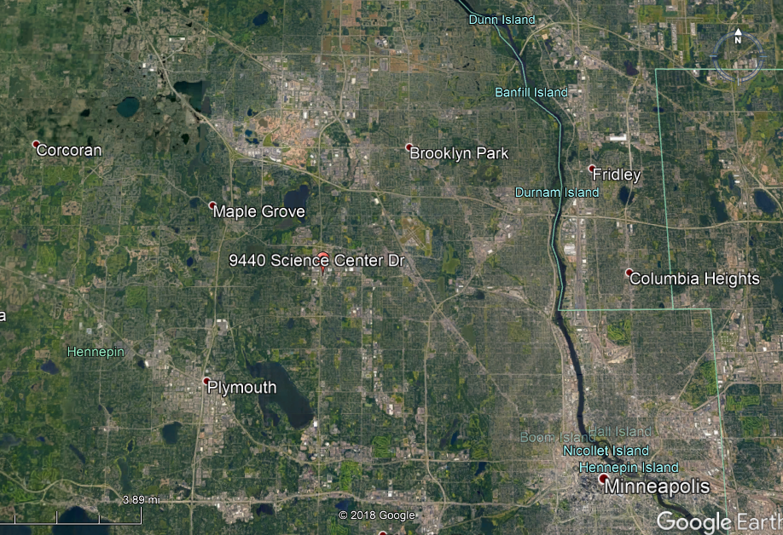



Slide 76
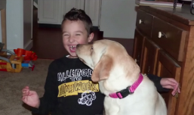
“How We Help”
Link (9:11)

Slide 77
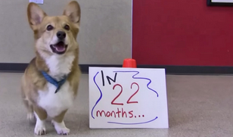
“In 22 Months”
link (2:17)

Slide 78

“25 Years of Service”
Link (3:42)

Slide 79

“Chad’s Journey”
Link (6:59)

Slide 80

“Dear Can Do Canines – Amy & Dinger”
Link (2:58)

Slide 81


